Slide 1







Student Success Indicators
Group 3 Presentation - 2024
Kelsea Thayer, Kayla Jehnzen, Cory Parker

Slide 2



About Project
The dataset from, UC Irvine Machine Learning Repository,
comprises of comprehensive information available at the time of student enrollment, including details about their academic path, demographic characteristics, and socio-economic background. Additionally, it encompasses data on the students' academic performance at the conclusion of their first and second semesters. This extensive dataset serves as the foundation for developing classification models designed to predict student dropout rates and academic success.

Slide 3








Dataset Includes
Grades
Parents Occupation
1st semester, 2nd semester, previous qualification grade, admission grade.
Occupation for each parent are labeled into 30 different sub-categories.
Nationality
We used a variable for nationality and a variable for national/international status. The majority of students are from the dataset home country of Portugal. Other leading countries of origin include France, Italy, Spain, and Brazil.
Tuition & Scholarship
Did the student receive a scholarship?
Are they up to date on paying tution?
Parents Qualification
Other Factors
Highest level of education completed for each parent.
Age at enrollment, course of study, gender, application method.

Slide 4


Machine Learning
Supervised
Unsupervised
We created a Logistic Regression Model and generated a confusion matrix. We also utilized a Random Forest Model.
We applied the K-means algorithm to identify the clusters in the dataset. We improved the efficiency of our clustering by applying principal component analysis (PCA).

Slide 5
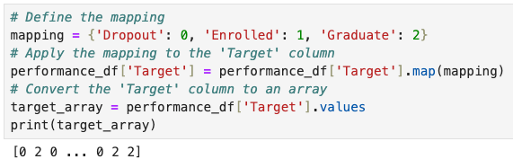
Target Mapping
Our goal was to use this data to predict the status of students. Students were marked as “Dropout”, “Enrolled”, or “Graduated”. We mapped these as 0, 1, and 2 to optimize the machine learning.

Slide 6
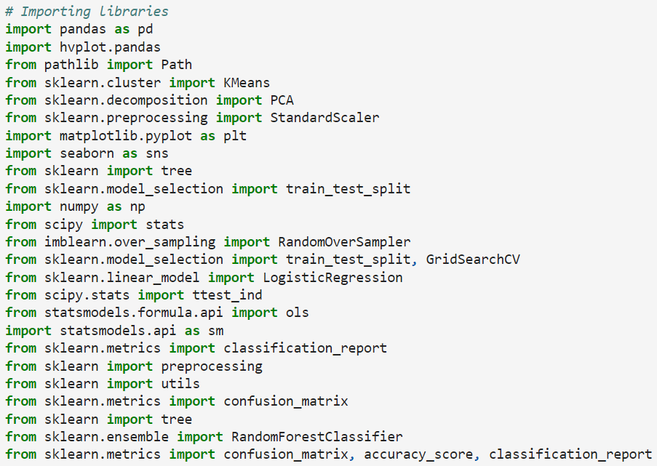
Libraries Used
Our main libraries utilized for our project were pandas, matplotlib, scipy, and sklearn.

Slide 7
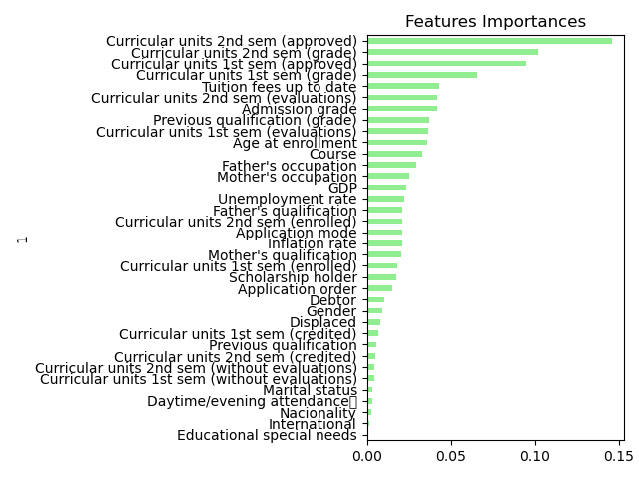
Features Importance
Most Important Predictors
The number of approved semester courses and the corresponding grades were the leading predictors - particularly 2nd semester. While we start to see some demographic predictors in the top half, the strongest indicators are directly tied to academic performance.
Least Important Predictors
It was interesting to find that nationality, marital status, displacement, gender, and daytime/evening attendance had very little importance on predicting accurate outcomes.

Slide 8


Slide 9
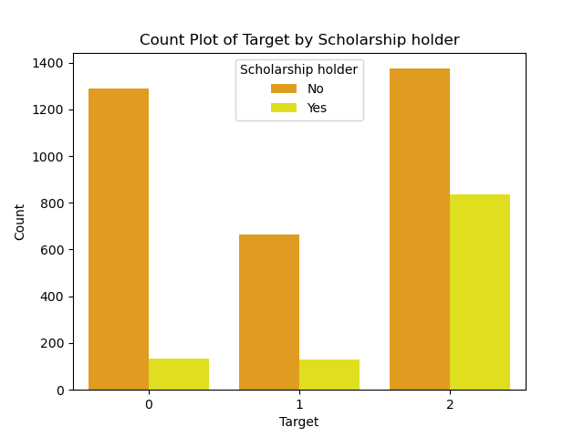
Scholarship Holders
Scholarship Importance
We found that non-scholarship students have a disproportionately higher dropout rate than students receiving scholarships. Many of the students who graduated were scholarship holders.

Slide 10
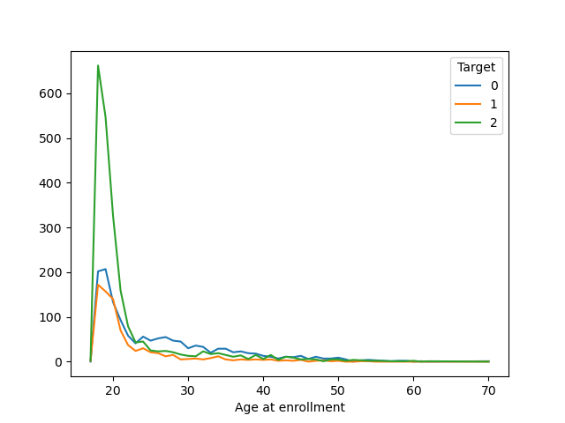
Age at Enrollment
Range and Trend
Students’ age at enrollment ranged from 17 to 70 years old. The data shows proportional result for younger students enrolling immediately following secondary school, while we see higher rates of droupout than graduate for students starting after age 25.
Notes:
A 70 year old student and a 61 year old dropped out while a 62 year old and two 60 year old students graduated.

Slide 11
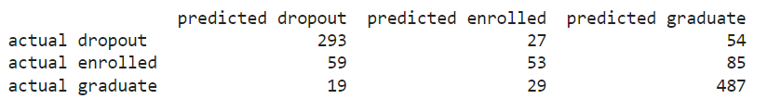
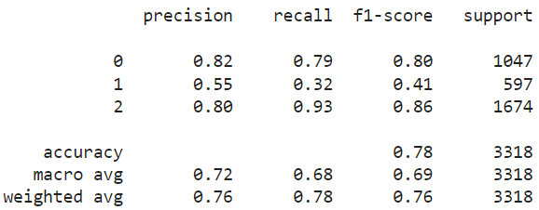
Accuracy
Confusion Matrix
The logistic regression model had a moderately high success rate predicting dropout and graduated students.
Training Report
Our logistic regression model achieved an accuracy score of 78%. Enrolled students were understandably difficult to predict.

Slide 12
Our Results
PCA and
K-Means
Logistic Regression
Random
Forest
The results of our model showed the first of 3 principal components explains 99.933% of the total variance in our data. The model had a 72% accuracy.
The Macro Avg:
Precision 0.76
Recall 0.78
F1-Score 0.76
Our Random Forest model accuracy was 76.8% accuracy. The Macro Avg:
Precision 0.71
Recall 0.67
F1-Score 0.68
Our logistic regression model had a 78% accuracy. The Macro Avg:
Precision: 0.72
Recall: 0.68
F1-Score: 0.69

Slide 13


What had the best predictions?
In our analysis, we evaluated multiple models to classify the data into three categories: Dropout, Enrolled, and Graduate. While the models showed very similar accuracy levels, achieving an overall accuracy of 77%, the Random Forest model stood out in its ability to provide detailed insights into our data.
Benefits of Random Forest Model
The Random Forest model not only matched the accuracy of other models but also offered valuable information through its feature importance metrics. This allowed us to understand which features were most influential in predicting the outcomes, offering deeper interpretability and insights into the underlying patterns in our data.
Negatives of Random Forest Model
Training a Random Forest model can be computationally expensive and time-consuming, especially with a large number of trees and large datasets. Although Random Forests are designed to reduce overfitting compared to single decision trees, they can still overfit.

Slide 14

Implications and Optimizations
Important Success Indicators
The highest predictors of success were credits taken and credits passed as well as if tuition was up to date. Admissions grade which is the GPA from high school was also a good predictor.
Unimportant Success Indicators
Grades without exam scores, nationality, special needs, and daytime/night attendance were among the most unimportant success indicators. Removing these inputs from the model can result in more optimal predictions.
Communication
By keeping stakeholders well-informed about these metrics, institutions can build trust, support, and a shared commitment to achieving educational excellence with early interventions.
Model Improvements
Model improvements might include binning of parents occupations and educations because these are assigned a number value as a key for qualitative information or deleting indicators that were not as important.
Future Usage
Insights from the model can inform the development of new programs or the modification of existing ones to better support student retention and success.

Slide 15
Conclusions
A predictive model for student outcomes holds immense potential for improving various aspects of higher education. By leveraging this model, institutions can enhance their support services, optimize resource allocation, inform strategic planning, and ultimately improve student retention and graduation rates. This proactive approach can lead to better educational experiences and outcomes for students, ensuring that more individuals successfully navigate their academic journeys.

Slide 16

Thank You
For Your Attention

